Slide 1
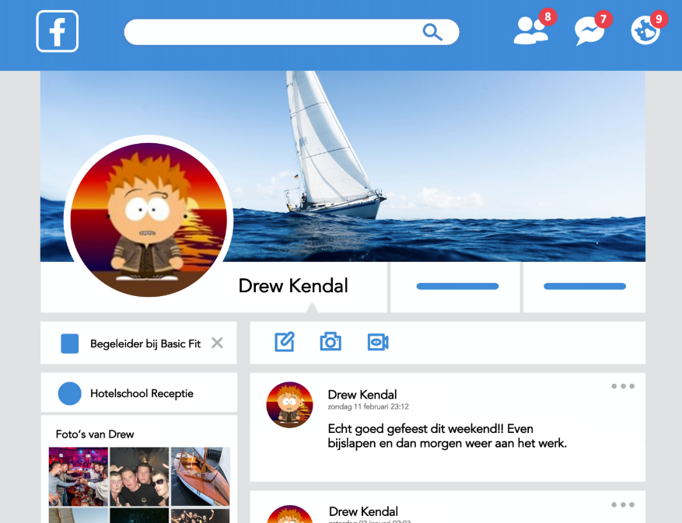
Training
Social Media Spy

Slide 2
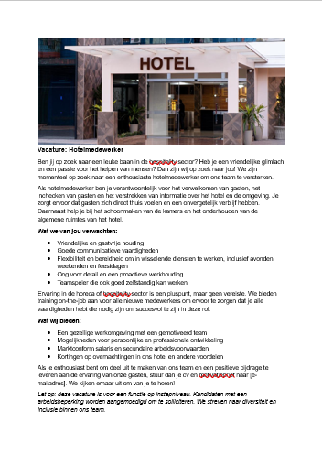
The Task:
You are the employer and will select someone who fits the job opening.
What do employers look for when someone applies to them?
Do employers consider social media? If so, how do you think they do that? What do they look for?
How do you think you can deal with this?

Slide 3
Round 1
First, thoroughly read the job description.
Examine the resumes and social media accounts, and decide who you think is the best fit.
Time: 15 minutes.

Slide 4
Round 2
Now, create your own resume where everything is either good or bad, tailored to fit the job opening.
Time: 20 minutes.

Slide 5
Conclusion
What did you think of this activity?
Are you satisfied with your chosen candidate?

